Slide 1

Quantum Computing :
Practical application still far away?
Team 1 : Mihir, Rachana, Shruti, Patrick, William

Slide 2
Table of Contents
1
Define the technologies assigned - the 5Ws and 1H
4
What are the current limitation and future concerns of the topics ?
2
How is this technologies being utilized ?
5
What may be some ways to expand the applications of this technologies ?
3
What are the current and future potentials of the topics ?
Slide by Rachana

Slide 3

01
The Technology - 5W and 1H
Slide by Shruti

Slide 4

5W’s and 1H
What
Encapsulates aspects of physics, computer science, and mathematics to solve complex problems.
Uses qubits instead of zeros and ones.
How
Operates on quantum principles like superposition, entanglement, and interference.
Why
Faster than classical computers.
Parallelism and Optimization.
Who
IBM, Google, Amazon, Microsoft, Intel, D-Wave, Quantinuum, Rigetti, Xanadu, and Atos Quantum.
Where
Cryptography, finance, logistics, operations, material science, machine learning, and AI.
When
Practical applications can be feasible few years or decades later.
Challenges like error correction, scalability, limited applicability, and high cost have to be addressed.
Slide by Shruti

Slide 5
02
How is this technologies being utilized ?
Slide by Patrick

Slide 6







Financial Monitoring & Risk Analysis
Improves financial modeling, option pricing, and risk assessment.
Climate Monitoring & Weather Forecasting
Enhances climate modeling simulations and weather forecasting accuracy
Drug Discovery & Material Science
Accelerates drug discovery processes and design of new materials with specific properties.
Machine Learning & Artificial Intelligence
Enhances machine learning algorithms for tasks like pattern recognition and optimization of large data sets
Supply Chain Management
Optimizes operations for inventory and route optimization
Cryptography
Breaks traditional encryption methods and enables quantum-resistant cryptographic algorithms.
Slide by Patrick

Slide 7
03
What are the current and future potentials of the topics ?
Slide by William

Slide 8





Space Exploration
Facilitate simulations and optimizations for space exploration missions, spacecraft designs, trajectory planning, and resource utilization in space
Smart Cities & Infrastructure
Optimize urban planning, transportation systems, energy distribution, and resource management in smart cities, leading to more sustainable and livable urban environments
Quantum Computing Ubiquity
As classical computers are integrated into various aspects of society today, quantum computers might be similarly ubiquitous
Virtual Reality
Power highly realistic and immersive virtual reality experiences by simulating complex virtual environments with unprecedented fidelity
Slide by William

Slide 9
04
What are the current limitation and future concerns of the topics ?
Slide by Rachana

Slide 10
Current Limitations
Future Concerns
Qubit Fragility : Quantum bits (qubits) are susceptible to environmental noise, causing information loss (decoherence). Robust error correction methods are crucial for reliable computations.
Hardware Stability : Maintaining the delicate state of qubits necessitates highly stable hardware environments is a significant engineering challenge.
Limited Qubit Connectivity : Entanglement, a core principle, allows qubits to work in unison. However, establishing and maintaining entanglement, especially across larger distances, remains difficult.
Algorithmic Development & Scaling : While some quantum algorithms outperform classical counterparts, ongoing research is needed to fully harness quantum capabilities. Scaling up qubit numbers exponentially increases complexity.
Security Risks : Quantum computers could potentially crack widely used encryption methods, necessitating new, quantum-resistant cryptography.
Ethical Concerns : The power of quantum computing raises ethical questions about potential misuse, privacy breaches, and novel cyber threats.
Access and Inclusivity : Ensuring equitable access to the benefits of quantum computing across different nations and institutions is an ongoing challenge.
Resource and Environmental Impact : Large-scale quantum computing facilities require significant energy consumption and specialized environments, raising environmental concerns.
Regulatory Challenges : Developing international standards and regulations is crucial for the responsible and secure development and use of quantum computing technology.
Slide by Rachana

Slide 11
05
What may be some ways to expand the applications of this technologies ?
Slide by Mihir

Slide 12
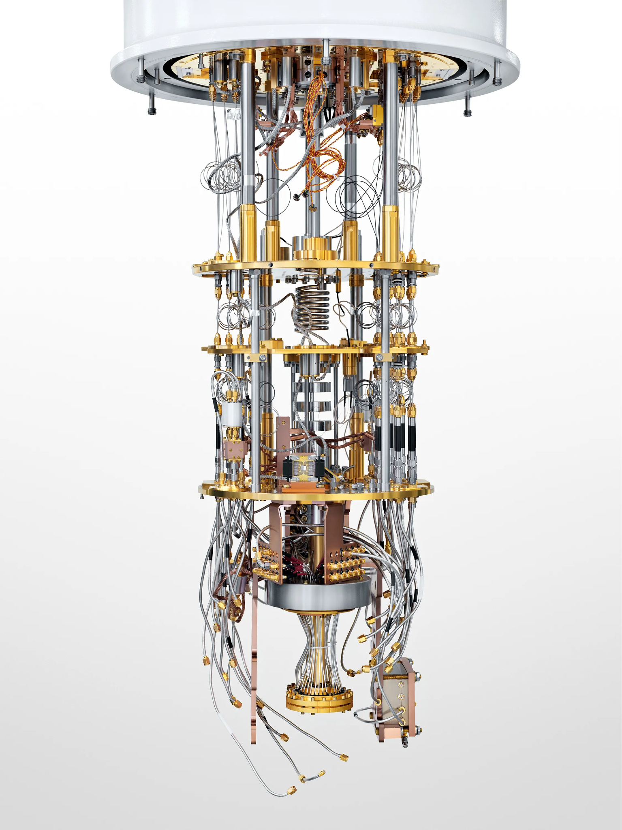
1. Improving Quantum Hardware
2. Developing Quantum Algorithms
3. Building Quantum Software and Tools
4. Fostering Collaboration and education
5. Legal and Ethical Framework
Longer Coherence Time.
Scaling up qubits.
Easy Error correction.
Algorithms suitable for Quantum Computers.
Hybrid classical and quantum algorithms.
Quantum software programming languages.
Simulation and modelling tools.
Interdisciplinary collaboration.
Education and Training.
Developing Standards.
Addressing security implications.
Slide by Mihir

Slide 13
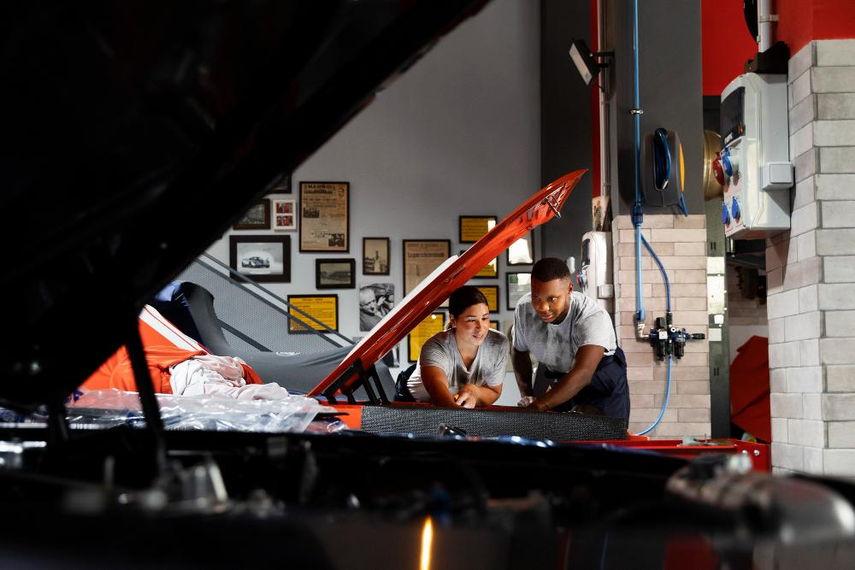
Thank You !
Any questions?

